Slide 1
Unit II – Leadership Skills
Chapter 2 - Leadership
Section 2 – Effective Leadership

Slide 2
Understand the principles of leadership and how you can become a successful leader

Slide 3
List the six traits of an effective leader
Describe the personal qualities of an effective leader
Explain the leadership opportunities in NJROTC

Slide 4
Finish this sentence:
Effective leaders ___________
___________

Slide 5
CPS Lesson Questions 1 - 2

Slide 6
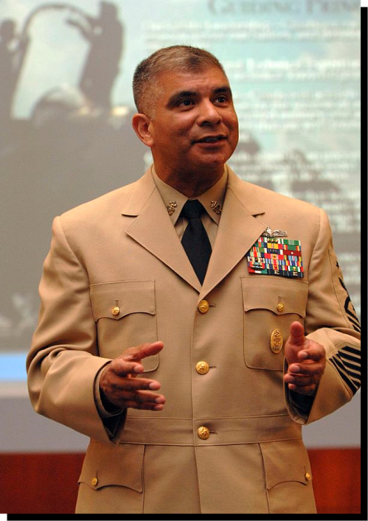
Six Traits of an Effective Leader
Effective leaders are defined by traits which form their character…. which is the basis for decisions made and the way they treat others.
Character shows in who you are and how you behave -24/7, wherever you are, whether someone’s watching or not.
MCPON
Joe R. Campa Jr.

Slide 7
Six Traits of an Effective Leader
Integrity
Loyalty
Commitment
Energy
Decisiveness
Selflessness
Let’s look a little deeper at each trait….

Slide 8
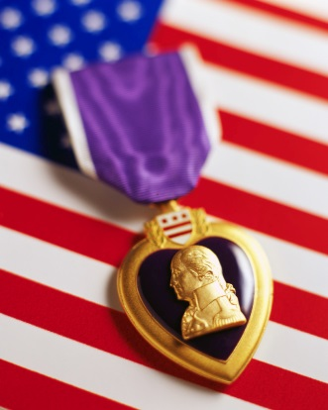
Leadership Traits - Integrity
If you have integrity, you have a clearly established set of values, and you are committed to sticking to them. You are honest and fair.
Integrity involves being a “whole person” – in mind, body and spirit.
People with integrity “do the right thing” no matter what.

Slide 9
Leadership Traits - Loyalty
Loyalty is faithfulness or allegiance, and it applies to superiors, peers and subordinates.
Leaders who are loyal to their team members will find that their team members will in turn show the same loyalty to them.
Loyalty goes a long way toward building a strong team.

Slide 10
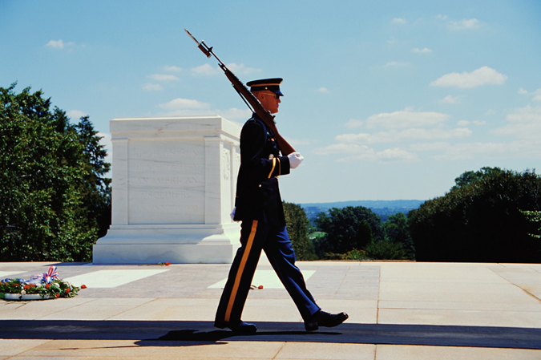
Leadership Traits - Commitment
A leader must set an example for the team of total dedication to the United States, the Navy and the team.
Commitment applies in situations where a person makes a conscious decision to stay the course in supporting a team- mate, a cause, a task or a mission.

Slide 11
Leadership Traits - Commitment
A leader must set an example for the team of total dedication to the United States, the Navy and the team.
Commitment is also a
Navy Core Value.

Slide 12
Leadership Traits - Energy
Enthusiasm and drive to take initiative make up energy. It is both mental and physical conditioning to get the job done.
The ad slogan “Just Do It” sums up applying your energy to the goals of your team and mission.
It’s important to apply your energy to persevere even when conditions aren’t optimal or convenient.

Slide 13
Leadership Traits - Decisiveness
A decisive leader has the self-confidence to act on a timely basis, then communicate those decisions to the team.
He/she must also accept responsibility for the outcome of the path he/she has chosen for the team.
It’s important to make a decision and stand behind it, no matter what.

Slide 14
Leadership Traits - Selflessness
A selfless leader sacrifices personal needs and wants, for the greater good of the team or cause.
Sometimes it’s necessary to make difficult decisions, requiring the ________ to face and overcome difficulties and physical dangers.
This is a trait that’s essential to military service.
courage

Slide 16
Personal Qualities of an Effective Leader
Courage
Responsibility
Ability to Set an Example
Self-Discipline
Self-Confidence
Sense of Humor
Tact
Common Sense
Now let’s explore each quality…

Slide 17
Leadership Traits - Courage
While courage against physical harm comes to mind first, situations requiring moral courage are more common.
You must call on your strength of
character to exercise both kinds
of courage.
Courage is also a Navy Core Value.

Slide 18
Leadership Traits - Responsibility
Taking responsibility and a willingness to be accountable is crucial for leadership.
As a leader, you should be willing to answer to your superiors as well as your followers.

Slide 19
Leadership Traits - Responsibility
Video about Responsibility

Slide 20
Leadership Traits – Ability to Set an Example
By his/her example, a leader sets a standard in the
unit, regarding:
Performance
Conduct
Appearance
The unit will notice the leader’s degree of self-control, and lack of it can impact team members in a negative way.

Slide 21
Leadership Traits – Self-Discipline
Young people who develop self-discipline will find that it serves them well in achieving goals in their life.
The self-disciplined person tends to be dependable and responsible on their own.
Those who don’t develop it on their own often need others to provide discipline for them.

Slide 22
Leadership Traits – Self-Confidence
Confidence comes with experience, and practicing leadership skills builds both.
As you learn to know yourself and your abilities, you become more confident and decisive.
The NJROTC program provides much opportunity to develop self-confidence.

Slide 24
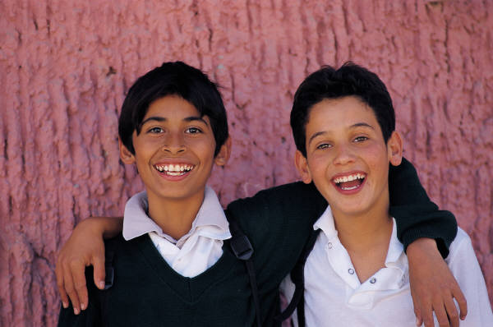
Leadership Traits – Sense of Humor
Without a sense of humor, a leader may struggle to ease tension or restore a group’s morale.
Sometimes “laughter is the best medicine,” allowing a fresh perspective and a re-start to a difficult situation.

Slide 25
Leadership Traits - Tact
Tact is defined as the ability to deal with others in a respectful manner, and encourages courteous treatment in return.
In stressful situations, tact is especially important. Being calm, courteous and firm generally brings cooperation in return.
A sarcastic “smart aleck” approach is generally not so positively received.

Slide 26
Leadership Traits – Common Sense
All the qualities listed before are important, but also critical is simple common sense.
The golden rule of treating others as you’d like to be treated, guides making the right choices in life in general.
Unsure about making a decision? Here are some questions to ask yourself to help decide…..

Slide 27
When Making Choices, Ask Yourself…
If I do what I’m thinking of doing, would I be willing to have my action enacted into law and required of everyone?
If I were considering using someone else for my own personal gain, would I allow someone to use me in that way?
Would I be willing to explain to a jury why I chose this action?
Would I do this if I knew it would be on tonight’s television news?

Slide 28
When Making Choices, Ask Yourself…
What would I think of this action if my worst enemy did it?
If my reason for acting this way is that everyone else does it, would I do it if no one else did it?
Would I do this if I knew I would have to explain my reasons to my family?
Would I be content with this action if my boss or a member of my family did the same thing?

Slide 29
When Making Choices, Ask Yourself…
Would I be content to have each of my followers behave exactly as I intend to in this situation?
If my team could win the game by violating a rule, would I be upset if the losing team took the same action?
If what I do hurts no one very much, would I be willing to let everyone do the same thing?
If there is very little harm in what I want to do, what kind of person will I become if it gets to be a habit?

Slide 30
Leadership Opportunities in NJROTC
Through your NJROTC unit, you have many chances to grow your leadership skills. You might lead on a variety of levels…
Unit
Platoon
Squad
Squad
Platoon
Squad
Unit with up to 150 members

Slide 31
Leadership Opportunities in NJROTC
Larger units are organized differently….
Battallon
Company
Platoon
Platoon
Company
Platoon
Squad
Squad
Squad
Squad
Squad
Platoon
Unit with 150 -300 members

Slide 32
Leadership Opportunities in NJROTC
The largest units have an additional layer…
Regiment
Battalion
Company
Company
Battalion
Company
Platoon
Platoon
Platoon
Platoon
Platoon
Company
Squad
Squad
Squad
Squad
Squad
Squad
Unit with more than 300 members

Slide 34
List 2-3 traits of an effective leader.

